Slide 1
Rocket Test Stand: Automated Sequence Logic
Analysis of control protocols for propulsion systems and safety management.
System Platform
PLCnext Engineer Engineering
Sinan ONA
230702005
DECEMBER 23, 2025
Notes:
"Good morning. My name is Sinan ONA. Today, Today I am presenting my project: Rocket Test Stand: Automated Sequence Logic. In aerospace engineering, control systems are about managing energy safely. My project focuses on designing a safety-critical protocol for propulsion systems, implemented using the PLCnext Engineer platform. My goal was to create a deterministic state machine that prioritizes safety over operation."

Slide 2


System Logic Overview
Sequence Design
Timer Logic
Safety Checks
A four-phase state machine manages the progression from system idle to engine ignition.
On-delay timers manage stabilization periods between different valve operations.
High-frequency sensor polling provides real-time monitoring of all safety limits.
Ensures all operations happen in a specific, safe order.
Prevents pressure spikes and ensures steady propellant flow.
Allows the system to abort instantly if any fault is detected.
Notes:
"Before we look at the code, here is the architecture. I designed a four-phase state machine to manage the progression from an idle system to engine ignition.
The system relies on two main engineering pillars:
Timer Logic: I utilized On-Delay timers to force stabilization periods between valve operations. This is crucial to prevent pressure spikes in the plumbing.
Safety Checks: The system uses high-frequency sensors. This allows the logic to abort instantly if a fault is detected.

Slide 3


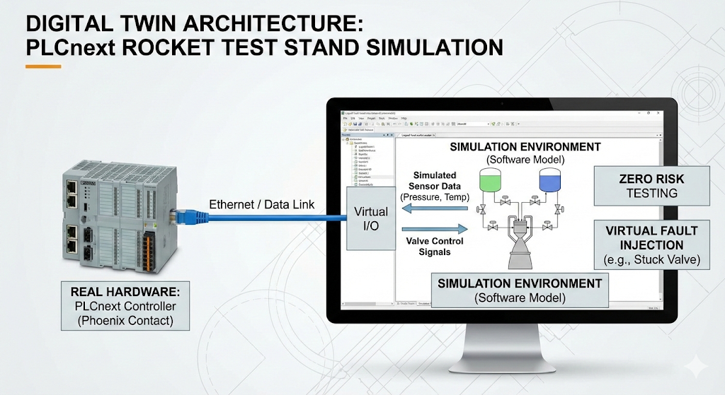
Simulation Environment
Why Simulation?
•
Simulated Sensors: We use software to generate fake pressure and temperature readings to trick the system into thinking it's running a real engine.
•
Virtual Valves: Instead of opening real valves, the code just flips a "digital switch." This lets us check if the logic works without needing hardware.
Figure 1.2: Digital "Twin" of the Rocket System.
•
Zero Risk: We can test dangerous things—like what happens if a valve gets stuck—without blowing anything up.
Benefit: Allows us to perfect the code safely before we ever build the real rocket stand.
Notes:
"Since I cannot build a physical liquid-fuel rocket engine in the lab yet, I validated this logic using a simulation.
As you can see in the diagram, I integrated the PLCnext controller with a simulation environment.
Why Simulation? It allows for Zero Risk testing. I can simulate dangerous scenarios—like a valve getting stuck—without blowing anything up.
The Mechanism: The software generates simulated pressure and temperature readings. This 'tricks' the PLC into thinking it is controlling real hardware, allowing me to verify my state machine logic safely."

Slide 4

Phase 1: Safety Verification
The system verifies environment and tank levels before arming.
// Safety Gate Logic
Safety_OK := (Wind < 25.0)
AND (Fuel_P > Min_P AND Fuel_P < Max_P)
AND (Ox_P > Min_P AND Ox_P < Max_P)
AND (Nitrogen > 2000.0);
Wind Stability
28.5km/h
Fluid Pressure
450psi
Fuel Level
92%
Oxidizer Level
98%
Notes:
"Now, let’s look at the logic itself. Phase 1 is Safety Verification.
This phase acts as a 'Safety Gate'. I implemented a Permissive Architecture, meaning the system defaults to a 'Safe' state and only arms if specific physical windows are met simultaneously.
I want to note here: The code snippet shown on the slide uses simplified, hard-coded values to make the presentation easy to follow. In a real system, these would be dynamic variables, but the logic remains the same.
We check four critical parameters:
Wind speed
Fluid pressusre for nitgoren
Fuel and oxidizer levels
When all these parameters are safe the “Safety_OK” variable goes to true and the system is armed.

Slide 5


Phase 2: Purge and Settle
Purge (7.5s)
Nitrogen flush clears the lines of moisture and debris.
// Purge & Settle Logic
TON1(IN:= Start_Purge, PT:= T#7.5s);
IF TON1.Q THEN
Close_Purge_Valve := TRUE;
TON2(IN:= TRUE, PT:= T#3.0s); // Settle
END_IF;
IF TON2.Q THEN Next_Phase := TRUE; END_IF;
Ensures clean lines for propellant flow.
Settle (3.0s)
Short delay allows the mechanical system to stabilize.
Verifies valves are correctly seated.
Notes:
"Once armed, we move to Phase 2: Purge and Settle.
First, the Purge: You can see TON1 in the code. This opens the Nitrogen valve for exactly 7.5 seconds.
ensuring 100% of moisture and oxygen is ejected.
Second, the Settle: Immediately after, TON2 enforces a 3.0-second 'All-Valves-Closed' state.
This pause allows turbulence and shockwaves to dissipate. This ensures our sensors read Static Pressure, not Dynamic Pressure, before we introduce fuel."

Slide 6

Phase 3: Valve Control
Operating Sequence
Step 1: Open Oxidizer Valve to pre-chill lines.
Step 2: Wait 10 seconds (TON3) for thermal stabilization.
Step 3: Verify Oxidizer Flow via feedback sensor.
Step 4: Release Fuel Valve Latch only if Oxidizer is confirmed.
// Valve Sequencing
Open_Ox_Valve := TRUE;
TON3(IN:= Ox_Feedback, PT:= T#10s); // Cooldown
IF TON3.Q AND Ox_Flow_OK THEN
Open_Fuel_Valve := TRUE;
ELSE
Fuel_Latch := LOCKED;
END_IF;
Notes:
"Phase 3 is the most complex phase: Valve Control.
We are dealing with Liquid Oxygen (LOX). If LOX hits warm pipes, it flash-boils into gas, causing cavitation. To prevent this, I wrote a specific sequence:
We open the Oxidizer Valve first to pre-chill the lines.
We wait 10 seconds using TON3 to allow for thermal equilibrium.
The Interlock: Crucially, the timer is not enough.
Just like in Phase 1, this code is a simplified abstraction. The core logic, however, is strict: Even if the timer finishes, if the sensor does not confirm the Oxidizer Flow is stable, the Fuel Latch remains LOCKED. The fuel valve will only open if the hardware is thermally ready." And to show this in the simulation environment I have added extra condition in the HMI interface.

Slide 7

Phase 4: Engine Ignition
1.0s
Ignition Confirmation
The igniter fires for 1 second (TON7). During this precise window, the flame sensor (TON4) must confirm successful combustion.
If the Flame_Detected signal is missing when the timer expires, the logic triggers an immediate SCRAM to prevent fuel pooling.
SAFETY WINDOW
The system shuts down instantly if no flame is detected within 1 second.
// Ignition Verification
TON7(IN:= Start_Ignition, PT:= T#1.0s);
TON4(IN:= Start_Ignition, PT:= T#1.0s);
IF Flame_Detected AND TON4.Q THEN
Run_State := TRUE;
ELSE_IF TON4.Q AND NOT Flame_Detected THEN
Abort_Sequence := TRUE;
END_IF;
Notes:
"Finally, Phase 4: Ignition. Here, timing is everything.
Igniter Duty Cycle: The igniter relay fires for exactly 1.0 second (TON7) to prevent the coil from overheating.
Safety Watchdog: This is the most important line of code, TON4.
The moment the fuel valve opens, a 1-second watchdog timer starts. If the Flame Sensor does not detect combustion before this timer finishes, the system assumes a misfire and triggers an immediate SCRAM (Emergency Shutdown). This prevents unburned fuel from pooling in the combustion chamber, which is a major explosion risk.

Slide 8

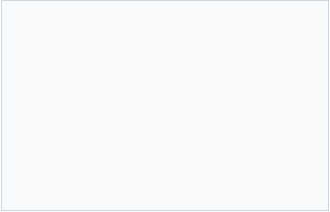

Emergency Protocols
Power Loss
Watchdog Timer
Manual E-Stop
All valves are normally closed (NC). Loss of power automatically shuts off flow.
Logic execution timeout triggers an immediate system shutdown to vent pressure.
Physical emergency button overrides all software to cut power instantly.
Notes:
"To ensure total safety, I implemented three layers of protection:
Power Loss: All valves are mechanically Normally Closed (NC). If power is cut, physics takes over and springs close the valves automatically.
Watchdog Timer: If the software freezes, a timer forces a shutdown to vent pressure.
Manual E-Stop: A physical override button that cuts the master relay."

Slide 9
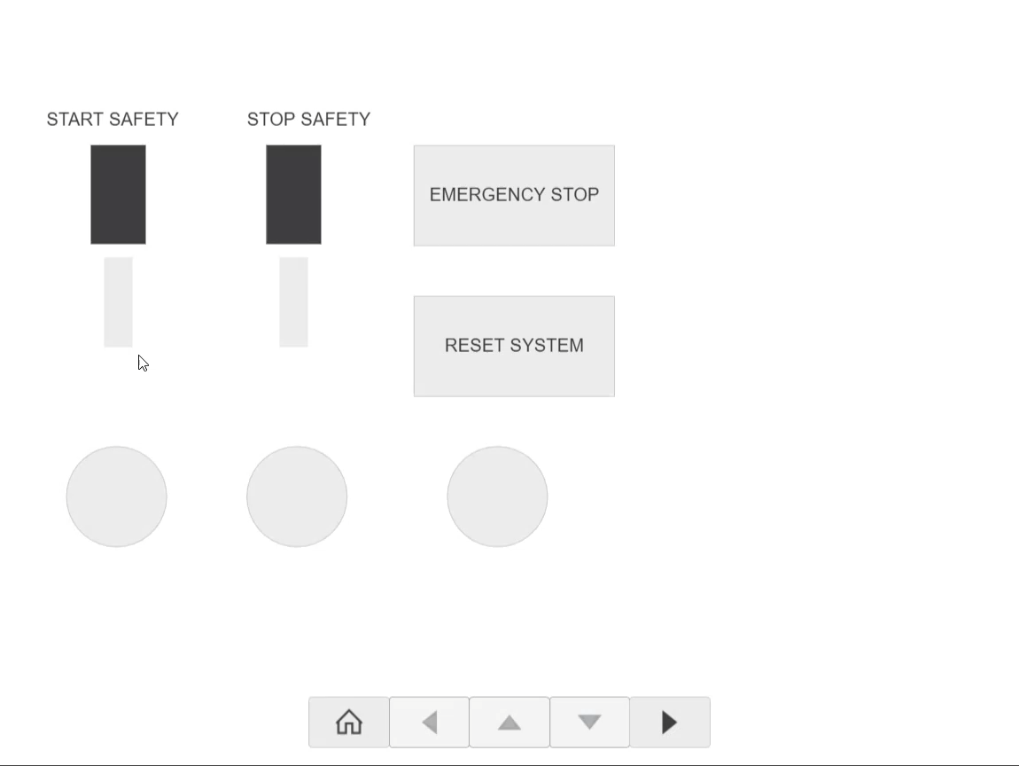
Operator Interface
HMI SYSTEM MONITOR
Notes:
"This is the HMI (Human Machine Interface) I designed for the operator.

Slide 10

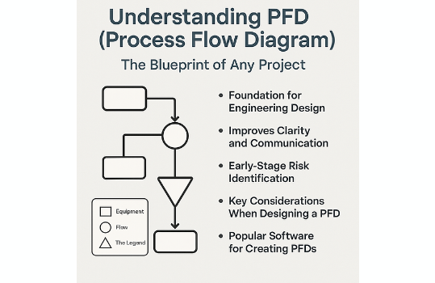
Future Development Roadmap
Planned System Upgrades
•
Physical System Deployment: Transitioning from SIL (Software-in-the-Loop) to physical hardware integration, including sensor calibration and valve assembly.
•
Scientific Computing Integration: Integrating Python and MATLAB bridges for real-time aerodynamic modeling and complex sensor fusion algorithms.
•
High-Speed Data Logging: Upgrading to a 1kHz sampling rate with SQL database integration for post-test analysis.
•
Figure 3.1: Process Flow Diagram for Next-Gen Control Loop.
Closed-Loop Control: Implementing PID algorithms for dynamic tank pressurization instead of static regulation.
Notes:
"To conclude, here is my roadmap for future development.
Currently, this is a 'Software-in-the-Loop' simulation. My next steps are:
Physical Deployment: Transitioning to Hardware-in-the-Loop, connecting the PLC to real sensors.
Scientific Computing: Bridging the PLC with Python and MATLAB for real-time aerodynamic modeling.
Closed-Loop Control: Replacing the current static logic with PID algorithms for dynamic tank pressurization."

Slide 11
Any Questions?
Thank you for your attention.
Notes:
Thank you for your attention

